Slide 1
Cambridge Compact
Energy Storage Opportunities
January 2018

Slide 2
$106,000,000,000 Billion
305 gigawatt-hours
1,064
will be invest in energy storage between
2016 and 2030 globally
Of energy storage will be installed globally by 2030
GW Generation USA
Source: BNEF. DOE.

Slide 3
Energy Storage Systems (EES)
US - Factoids
1
EES systems are often expressed by rated power in megawatts (MW) and energy storage capacity in megawatt-hours (MWh).*
As of April 2017, the U.S. had over 24.2 GW of rated power in energy storage.
2.5% of delivered electric power in the U.S. is cycled through a storage facility.
U.S. energy storage increased by 105% from 2013 to 2016.
California leads the U.S. in energy storage with 198 operational projects (4.3 GW), followed by Virginia and Texas.
Source: UMICH. DOE.
Notes:
Source: http://css.umich.edu/factsheets/us-grid-energy-storage-factsheet
* The maximum charge/discharge power, and the amount of energy capable of being stored, respectively.
** (Compared to 1,081 GW of total in service installed generation capacity). Globally, installed energy storage totaled 175.9 GW.
***For comparison, 10% of delivered power in Europe and 15% of delivered power in Japan are cycled through energy storage facilities.

Slide 4
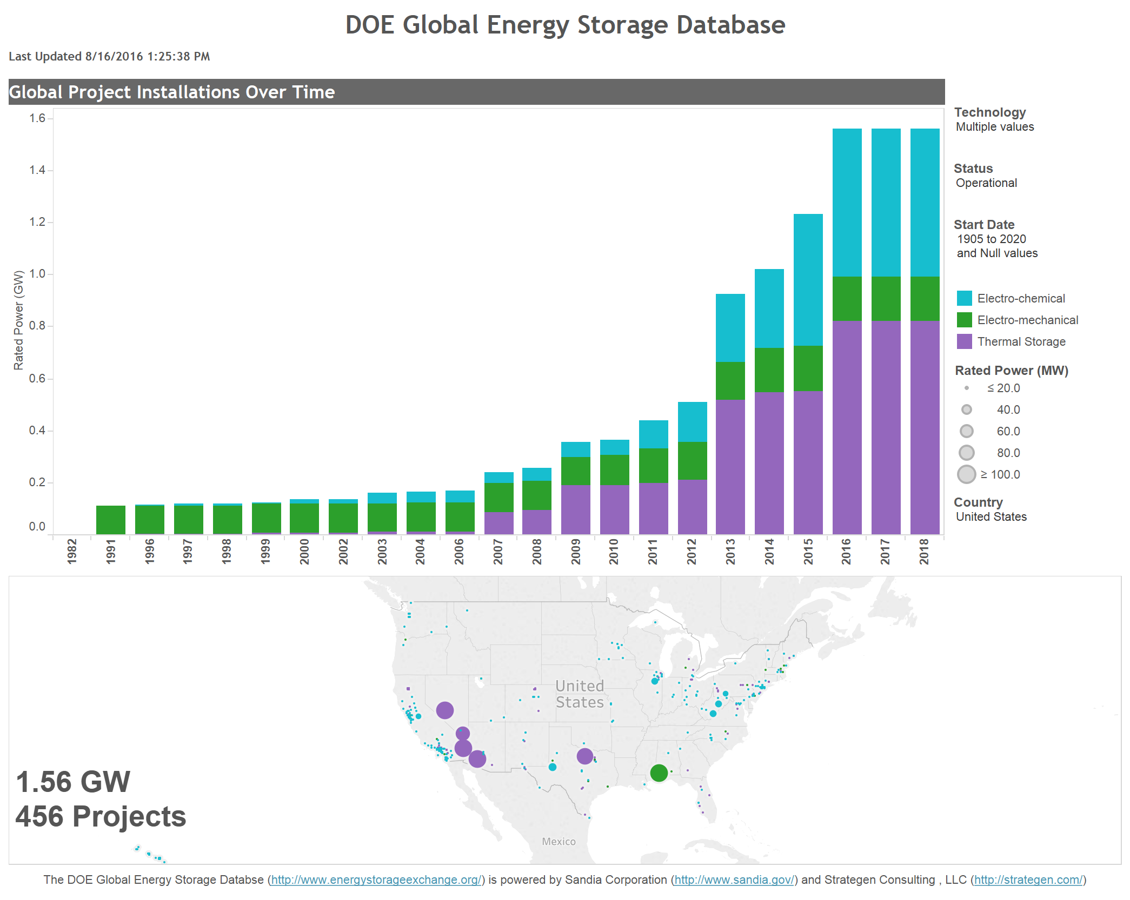
DOE Global Energy Storage Database
Notes:
*Excludes Pumped Hydro Systems
http://www.energystorageexchange.org/projects/data_visualization

Slide 5
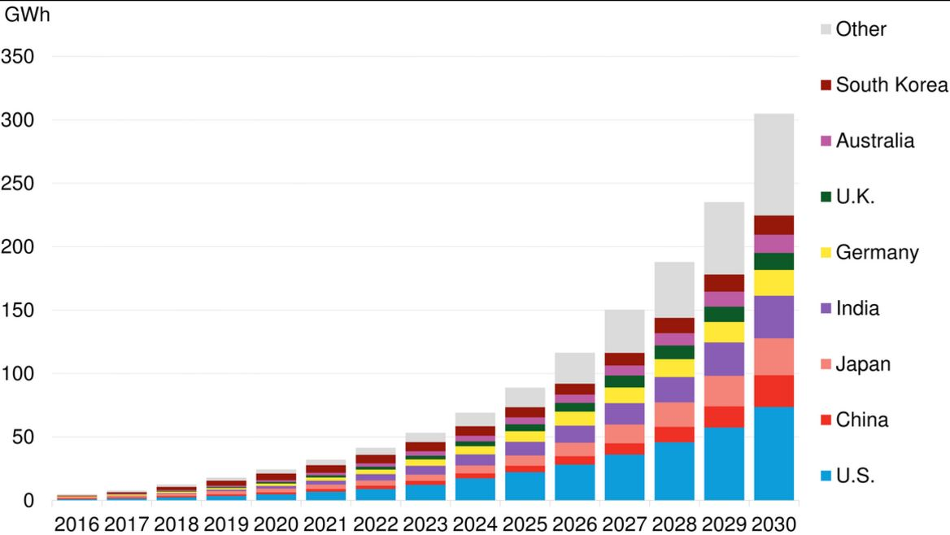
Global cumulative storage deployments Projections
Source: BNEF.
Notes:
https://about.bnef.com/blog/global-storage-market-double-six-times-2030/

Slide 6
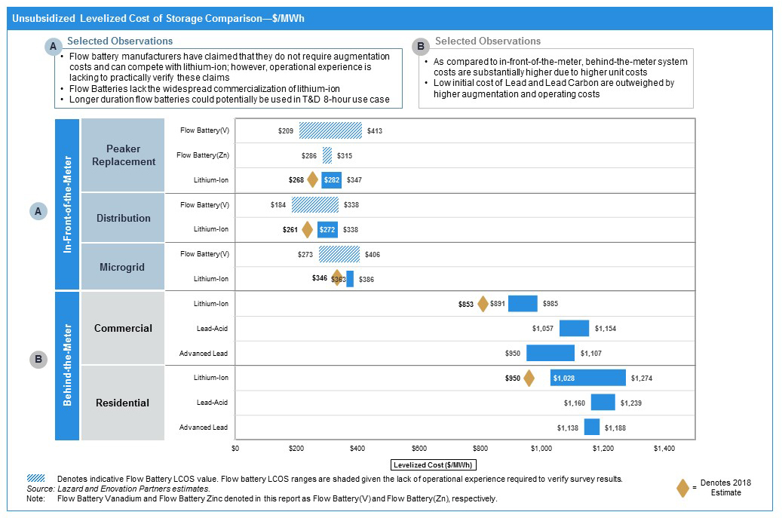
Levelized Cost of Storage Analysis
Source: Lazard.

Slide 7
Central Takeaways
Energy Storage Market for commercial use is new, and fragmented.
Business models vary, are evolving and adapting, and may not follow the “traditional” Tesla Model. (i.e. STEM)
While previous years saw very slow growth, 2017 experienced 150% growth.
____ + Storage is currently the most economically feasible.
There are multiple current opportunities for Cambridge Compact members:
  SMART Program (Solar + Storage), Eversource, Enernoc, STEM
  Partnerships: University Pilots,....

Slide 8
Consumer Energy Storage Systems Primer

Slide 9
Consumer ESS
Basics of Storage
Describe energy technologies and how those apply to members of the Compact.
Case Studies
Examine examples study cases:
Global
USA
MA
State of the Market
Economics, Private & Public sector roles, Environmental Impact.
1
2
3

Slide 10
Technologies, Value proposition, and solutions

Slide 11
Basics of Energy Storage
1
Quick Summary of Storage Technologies

Slide 12
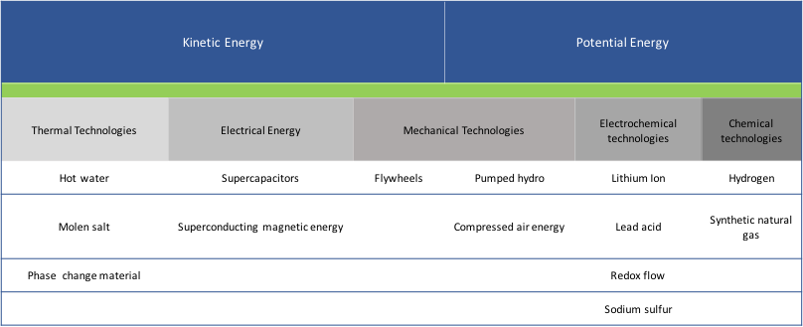
Energy Storage Technologies
1
Source: Deloitte
Notes:
https://www2.deloitte.com/content/dam/Deloitte/us/Documents/energy-resources/us-er-energy-storage-tracking-technologies-transform-power-sector.pdf
Kinetic = Energy in movement

Slide 13
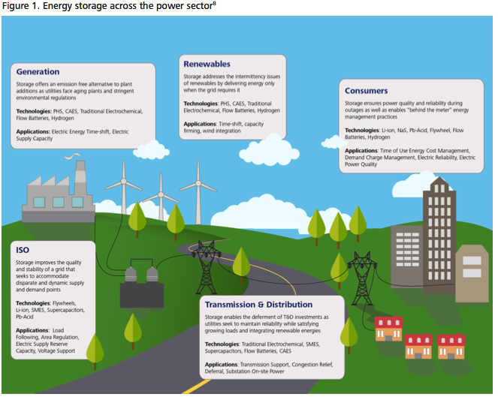
Figure 1. Energy Storage Across the power sector
Generation
Storage offers Emission free alternatives to plant additions as utilities face aging plants and stringent environmental regulations
Technologies: PHS, CAES, Traditional Electrochemical, Flow Batteries, Hydrogen
Applications: Electric Energy Time-shift, Electric Supply Capacity
Renewables
Storage addresses the intermittency issues of renewables by delivering energy only when the grid requires it
Technologies: PHS, CAES, Traditional Electrochemical, Flow Batteries, Hydrogen
Applications: Time-shift, capacity firming, wind integration
Consumers
Storage ensures power quality and reliability during outages as well as enables “behind the meter” energy management practices
Technologies: Li-ion, NaS, Pb-Acid, Flywheel, Flow Batteries, Hydrogen
Applications: Time of Use Energy Cost Management, Demand Charge Management, Electric Reliability, Electric Power Quality
ISO
Storage improves the quality and stability of a grid that seeks to accommodate disparate and dynamic supply and demand points
Technologies: Flywheels, Li-ion, SMES, Supercapacitors, Pb-Acid
Applications: Load Following, Area Regulation, Electric Supply Reserve Capacity, Voltage Support
Transmission & Distribution
Storage enables the deferment of T&D investments as utilities seek to maintain reliability while satisfying growing loads and integrating renewables energies
Technologies: Traditional Electrochemical, SMES, Supercapacitors, Flow Batteries, CAES
Applications: Transmission Support, Congestion Relief, Deferral, Substitution, On-site Power
Source: Deloitte
Notes:
Source: https://www2.deloitte.com/content/dam/Deloitte/us/Documents/energy-resources/us-er-energy-storage-tracking-technologies-transform-power-sector.pdf

Slide 14
Primary Value Proposition
1
“Electricity storage can be used to reduce the cost incurred for electric service. The benefit can be significant. There are two variations on this value proposition.” (ESA)
Time of use energy cost management:
  One involves electricity end-users that pay “time-of-use” (TOU) electric energy prices. That is, the price paid depends on the time that it is purchased.
Demand charge management (Capacity Charges):
  Second, commercial and Industrial end-users that use a significant amount of electricity qualify for electrical service pricing that includes both a) TOU energy pricing and b) demand charges.
Secondary value propositions (especially as the market evolves and prices get richer)
  Electric reliability
  Electric power quality (ability to track energy source behind the meter)
  Flexible Power Peaking Resource (Provides ability to sell power to utilities)
  Electric Energy Time Shift
  Resilience (Emergency management: i.e: Worst case scenario emergency preparation)
Demand Response Response Payments in reaction to emergencies that threaten the grid:
  New England Demand Response Management (ENERNOC)
Notes:
* = Districts
Warehousing energy from diverse resources for use at a different time is only one of the many applications of energy storage. Storage technologies also improve the quality of power through frequency regulation, allows companies to produce power when it is cheapest and most efficient, and provide an uninterruptible source of power for critical infrastructure and services.
Expand on the needs. Use an example.
What these batteries solutions are actually for.
http://energystorage.org/energy-storage/technology-applications/end-user-bill-management:
Electricity storage can be used to reduce the cost incurred for electric service. The benefit can be significant. There are two variations on this value proposition.
One involves electricity end-users that pay “time-of-use” (TOU) electric energy prices. That is, the price paid depends on the time that it is purchased.
Second, commercial and Industrial end-users that use a significant amount of electricity qualify for electrical service pricing that includes both a) TOU energy pricing and b) demand charges.
Demand charges reflect the end-user’s maximum power draw rather than energy use. Storage used to manage an end-user’s bill could also be used to provide the same functionality as an uninterruptible power supply (UPS). It could be used by the electricity end-user to time-shift energy from on-site photovoltaics (PV) or other generation system, or the storage could assist with integration of other nearby PV systems. As the electricity market structure evolves and as pricing becomes richer, the storage could also be aggregated and operated in concert with other distributed resources as a very flexible and reliable resource.

Slide 15
Other Advantages:
Traditional Vs The Future Grid
1
“Energy Storage is expected to provide numerous benefits in many possible combinations.” As the grid becomes smarter and technology costs decrease, storage flexible properties will increase its value. Distributed systems behind the meter would become not just ways to save on energy costs, but also act as assets which generate returns. For example:
  Frequency Regulation
  T&D Upgrade Deferral
  Transmission Support and Avoidance of Congestion Charge
  Ramping
Storage is more responsive than generation-based peakers like. The ability to both “absorb” and discharge energy adds to storage flexibility.
Storage used for peaking could be used for ancillary services during thousands of hours per year. (frequency control, spinning reserves and operating reserves.)
There are no direct emissions from storage and most storage types produce limited or noise so it may be easier to site than generation-based peakers.
Source: Energy Storage Association.
Notes:
CES is expected to provide numerous benefits in many possible combinations. It can serve as a robust, fast-responding and flexible alternative to generation. It can store low priced energy and use that energy when the price is high. CES can also be used to provide most types of “ancillary services” that are needed to keep the electrical grid stable and reliable. Depending on the location, CES may reduce the need for transmission and distribution (T&D) capacity because CES provides power locally, so less T&D equipment is needed to serve the local “peak demand.” CES can also improve the local electric service reliability and power quality. Of particular interest is CES used to maintain a stable voltage in the distribution system.
CES can play an important role in the integration of renewable energy (RE) generation into the grid, including large scale/remote wind generation and distributed (e.g. rooftop) photovoltaics. CES addresses two notable RE generation integration challenges. First, CES can be charged with wind generation output, much of which occurs at night when the energy is not very valuable. In some circumstances,demand for energy is less than the amount being generated, so wind generation is “curtailed” (turned off) or the system operator must pay someone to take the energy. By charging at night, CES takes advantage of the time when transmission systems are less congested and more efficient. Second, CES can be used to manage localized “power quality” related challenges posed by high penetrations of photovoltaics systems, especially in residential areas. Of particular note are undesirable voltage fluctuations that occur such as those associated with rapid variations of output due to passing clouds.
Some important advantages of storage – used to serve peak demand – include the following:
Storage can serve a broader array of applications than peakers or demand-side approaches.
Most storage types tend to startup much faster than peakers and their output can be varied – {ramping} – much more rapidly than peakers’ output, so storage is a significantly more flexible alternative.
Because most storage peaker charging occurs at night, storage used as peaking resources increases utilization of cleaner, more efficient “{baseload}” generation and will increase utilization of transmission capacity and, depending on the location, it may also increase utilization of distribution capacity (“increased asset utilization”).
There are no direct emissions from storage and most storage types produce limited or noise so it may be easier to site than generation-based peakers.
Some storage types are modular and thus can be deployed and operated in distributed mode, where they are most effective and/or most valuable. If it is also transportable, modular storage can be redeployed in other locations, as conditions and needs evolve and to so its benefits can be optimized.

Slide 16
What Technologies Are Commercially Available?
1
Solid State Batteries:
  NaS (Sodium Sulfur), Li-ion, Ni-CD
    Proven and chosen technologies today
    Li-ion = Lithium + various combinations of chemistries
Flow Batteries
  Redox Flow Batteries, Iron-Chromium (ICB), Vanadium-redox (VRB), Zinc-Bromide(ZNBR)
  Ability to scale and expand, longer life time, and battery is not aged by charge and discharge.
SMES (Superconducting Magnetic Energy Storage), Flywheels, and Supercapacitors
  High Power Output at once
Thermal (District energy systems)
  Pumped Heat Electrical Storage, Hydrogen, Liquid Air
  Harvard, City of Chicago
CAES (Compressed Air)
  Equivalent to Pumped Hydro Systems
Source: Energy Storage Association.
Notes:
Tesla’s giant battery in Australia made around $1 million in just a few days
Energy Storage Technologies:
http://energystorage.org/energy-storage-1,
https://www2.deloitte.com/content/dam/Deloitte/us/Documents/energy-resources/us-er-energy-storage-tracking-technologies-transform-power-sector.pdf
Salient Point Solid State: Ability to use energy at once Vs. longer periods of time, Think:Tesla long range vs Porsche Le Man Racing Hybrid car.
How does a Lithium Battery Work:
https://energy.gov/eere/articles/how-does-lithium-ion-battery-work
https://www.bnl.gov/newsroom/news.php?a=212678

Slide 17
Solid State
1
Li-on
Best technology for commercial needs
Lead(Pb) Acid
Most affordable today but on its way out
Sodium-sulfur (Nas)
Created in the 1960’s, mostly used in Japan. Expect it to become an alternative to Li-on.
Notes:
https://www.slideshare.net/e4sv/banglore-jul16-ces-is-at-the-forefront-of-competitive-electricity-markets-and-emerging-technology-trends (Page 12-17)

Slide 18
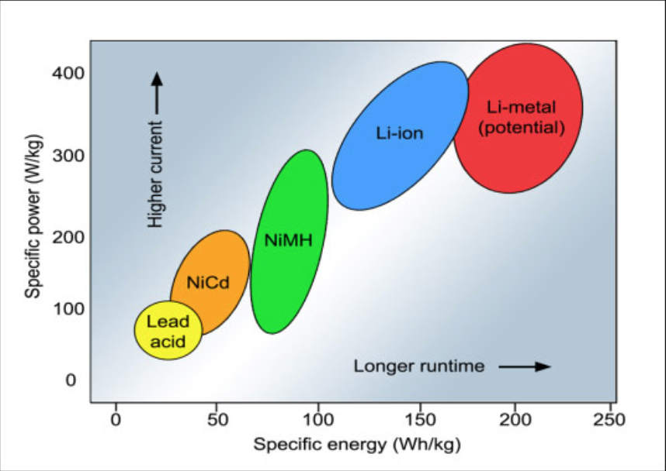
Newest Tesla cell Is already at 250 wh/kg
ElectroChemical Efficiency Curve
Notes:
http://batteryuniversity.com/learn/article/global_battery_markets
Newest Tesla Cell Is at 250 wh/kg. Re-do Graph/. Year?
Figure 2: Specific energy and specific power of rechargeable batteries.
Specific energy is the capacity a battery can hold in watt-hours per kilogram (Wh/kg); specific power is the battery’s ability to deliver power in watts per kilogram (W/kg).
https://www.bloomberg.com/news/articles/2017-05-22/move-over-tesla-europe-s-building-its-own-battery-gigafactories

Slide 19
Li-Ion
1
Battery manufacturing set to double from the current 140k to 280k megawatt-hours
On a dollar per kilowatt-hour Lithium-ion technologies in 2016 prices where $273 dollars, and in 2020 is expected to be at $170. This is an average. According BNEF, there are pack prices below $200 per kilowatt-hour.
High energy densities, high power, near 100% efficiency, and low self-discharge.
Source: BNEF.

Slide 20
Other Options (Max 3 slides)
1
Flywheel
Established technology with few commercial players.
Mass commercial scalability not proven yet.
Flow-Battery
Harvard has developed the most technology ready flow-battery.
Currently looking for pilot programs.
Notes:
Include Thermal?
A flow battery uses two electrolytes, often different kinds of the same chemical compound. Both the positive and negative electrolytes are stored separately and are pumped through a cell. Inside the cell, the two electrolytes are kept separate. The electrochemical reaction takes place by transferring ions across a membrane as shown in Figure 12.6. The electrodes do not take part in the chemical reaction and thus do not deteriorate from repeated cycling (one of the problems in other types of batteries that leads to loss of performance over time).
Hydrogen: Most fuel cells use H 2 and O 2 as their main fuel (Figure 12.7). At the negative electrode, hydrogen is oxidised to form H + and electrons. The electrons flow through the external electrical circuit whereas the hydrogen ions move towards the positive electrode through the electrolyte. The positive electrode is made from a porous material coated with a catalyst. At that electrode, the hydrogen ions combine with oxygen to produce water. Many different types of fuel cells have been developed and their characteristics are listed in Table 12.1.
Flywheel: Flywheels store kinetic energy in a rotating mass and release it by slowing the rotation when electrical energy is required. Their application to date has mainly been for power quality and to provide energy for UPS. The majority of installations are on customers' premises with a very few applications in demonstration micro-grids.
Source: Smart Grid: Technology and Applications
http://proquest.safaribooksonline.com.ezp-prod1.hul.harvard.edu/book/electrical-engineering/power-systems/9780470974094/firstchapter?reader=pf&readerfullscreen=&readerleftmenu=1#X2ludGVybmFsX1BGVmlldz94bWxpZD05NzgwNDcwOTc0MDk0JTJGMjY3Jl9faW1hZ2VwYWdlcmVzb2x1dGlvbj04MDAmcXVlcnk9

Slide 21
Case Studies
2
Global, US and State Level

Slide 22
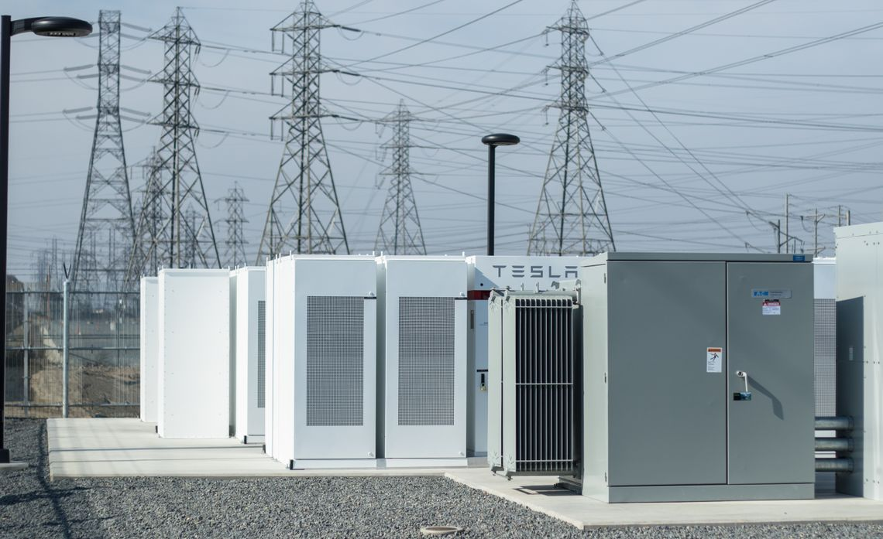
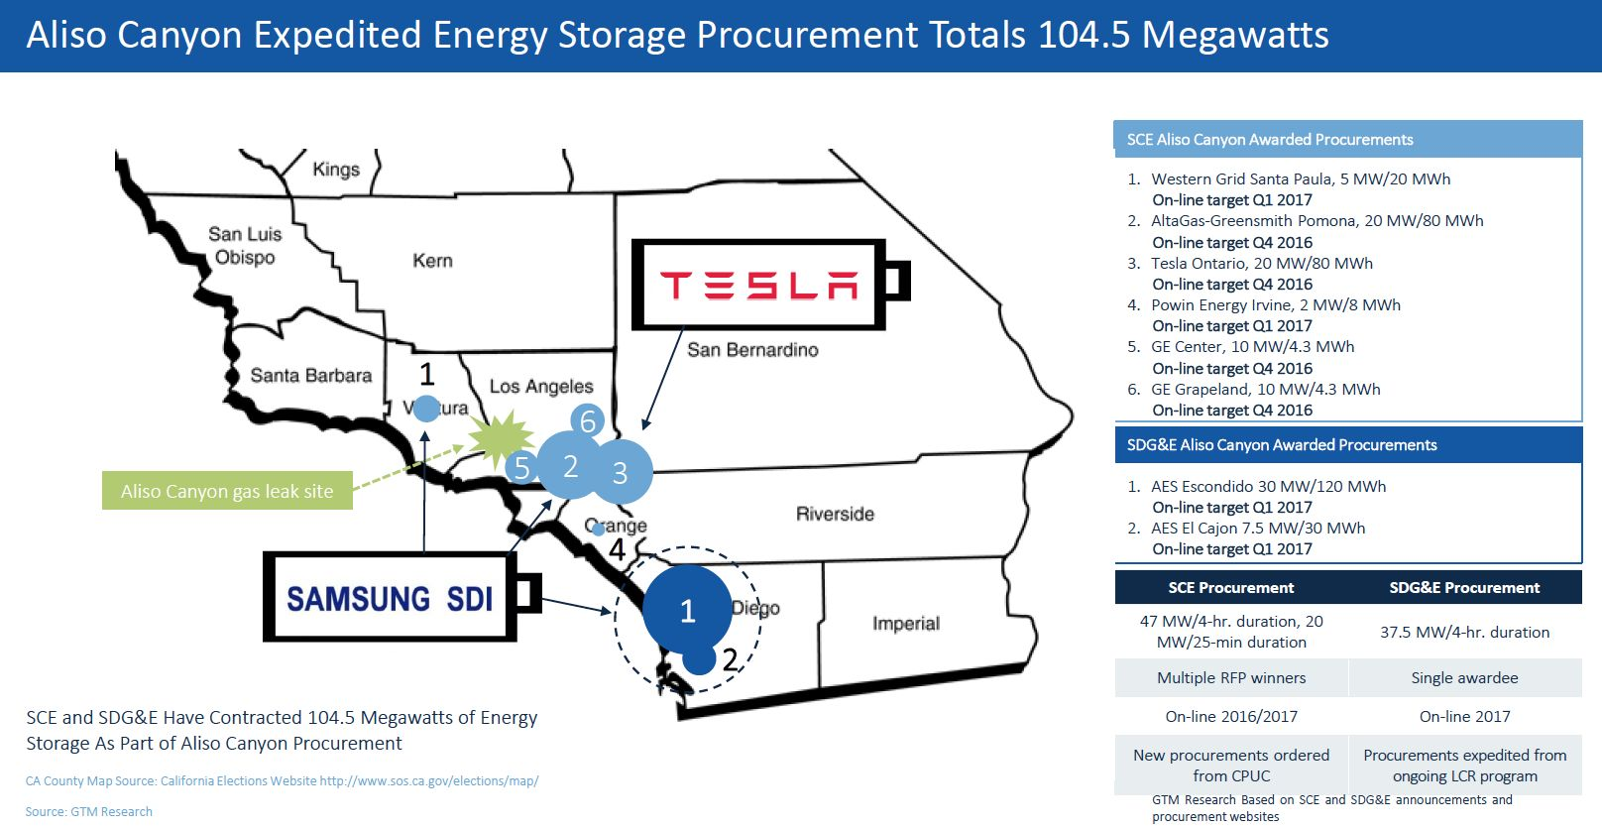
Aliso Canyon - California -
Resiliency Need
2
“It validates that energy storage can be part of the energy mix now.” Kevin Payne, CEO of SCE
“The 20-megawatt, 80-megawatt-hour installation is capable of powering 15,000 homes for a 4-hour period”
“Built to last for 10 years, perform daily cycles and provide high power all from a single, compact turnkey system.”
Source: Green Tech Media
Notes:
https://en.wikipedia.org/wiki/List_of_energy_storage_projects#cite_ref-DOE_14-0
https://www.greentechmedia.com/articles/read/aliso-canyon-emergency-batteries-officially-up-and-running-from-tesla-green#gs.5atnqzc

Slide 23

Massachusetts - Pumped Hydro
2
The Bear Swamp complex, completed in 1974, is on the Deerfield River in Rowe and Florida, Massachusetts.
Bear Swamp comprises an underground pumped storage generating station and two conventional hydroelectric stations.
Produce a maximum of 600 megawatts of peaking power
Source: DOE Energy Storage Database

Slide 24
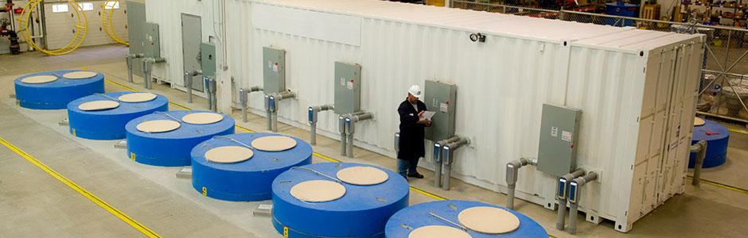
Commercial - Beacon Power - Tyngsboro, Massachusetts-
Flywheel
2
Supplies frequency regulation services to ISO-NE.
500 kW
Commissioned 2008
Source: DOE Energy Storage Database

Slide 25
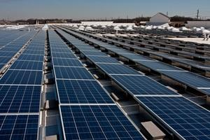
BJ's Wholesale Club - SolarCity / Direct Energy - (Framingham, MA)
2
Operational since february 01/2015
Some results here: Better Buildings Case Study
Limited information on results
Uses:
  Electric Bill Management
  Electric Bill Management with Renewables
  Electric Energy Time Shift
  Renewables Energy Time Shift
Source: Better Buildings DOE Study

Slide 26
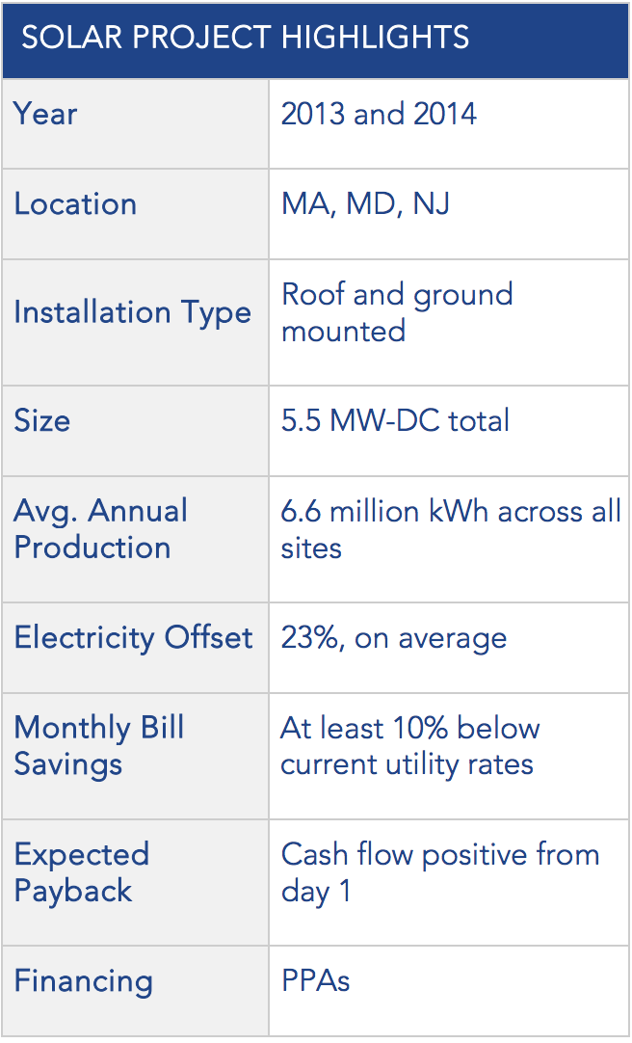
BJ's Wholesale Club - SolarCity / Direct Energy - (Framingham, MA)
2
“BJ’s Wholesale Club also recommends that other companies that lease their building and are interested in solar energy determine the potential increase in equity value solar brings to a building over time. While there will always be some negotiation between property owner and tenant regarding shared risks, having a building with lower operating costs than the building across the street provides a competitive advantage to both parties.”
Source: Better Buildings DOE Study

Slide 27
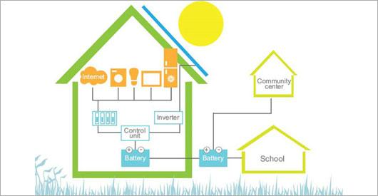
Community Energy Storage - Nottingham, UK
2
The project runs from 2014 to mid-2018 and will explore the potential for using energy storage technologies such as batteries within communities to reduce their fuel costs and overall energy use.
Project Sensible EU
  The overall objective of Project SENSIBLE is to develop, demonstrate and evaluate a storage-enabled sustainable energy supply for buildings and communities.
Source: Mozes
Notes:
http://www.mozes.co.uk/
http://www.nottenergy.com/projects/domestic/sungain_battery_storage_project/
http://www.nottingham.ac.uk/news/pressreleases/2017/may/pioneering-community-energy-storage-project-in-nottingham-connects-its-first-household-battery-storage-system-to-the-grid.aspx.aspx
http://www.h2020-project-sensible.eu/demonstrator-sites/nottingham-demonstrator-site.aspx

Slide 28
Harvard Thermal Energy Storage Project
Allston: ~8 MWe
2
Thermal energy storage to reduce peak demand and improve efficiency of cooling provided to buildings
Higher Round Trip Efficiency than traditional electric storage batteries
Other thermal storage Projects in Florida and Chicago
Notes:
Similar Project: Florida Public Schools

Slide 29
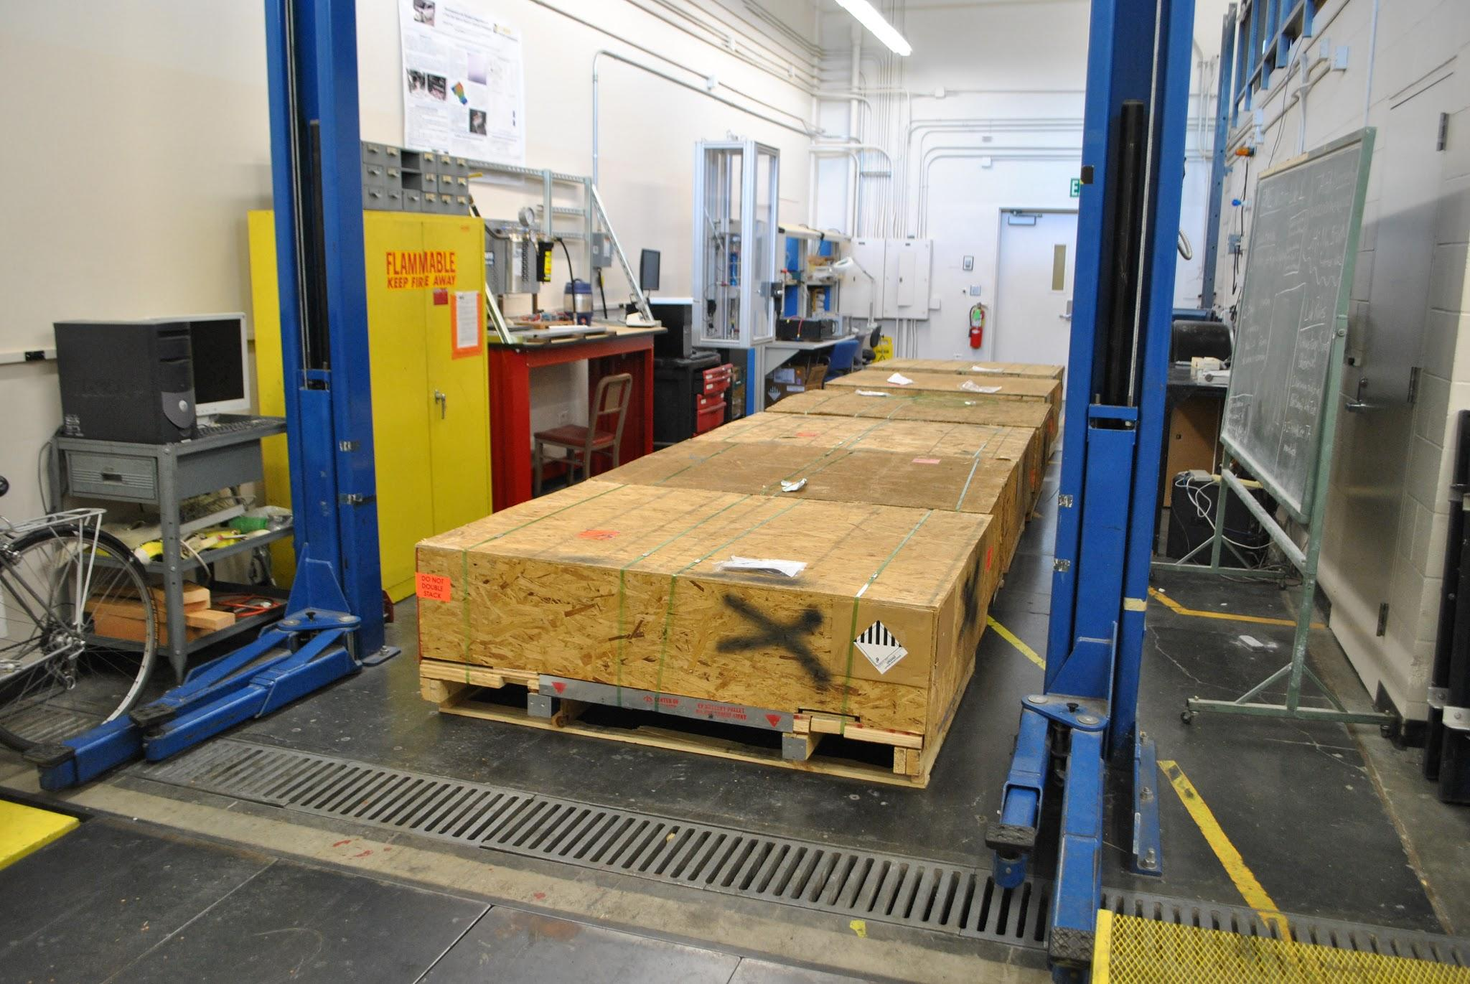
University - Research -
UC Davis -
2
Research project for Second life application of EV batteries
Building a smart Electrical Energy Storage (EES) system(microgrid) using retired Electric Vehicle (EV) batteries
The batteries in an electric vehicle are usually retired after their State of Health (SoH) reaches 75-80%.
Shipment of Nissan LEAF batteries, courtesy of Nissan, 4REnergy and Sumitomo Corp.
Source: UC Davis
Notes:
http://mae.engr.ucdavis.edu/jwpark/DavisSite/pages/BWF-microgrid.html#whyUS

Slide 30
UC SAN DIEGO
2
BMW Energy Storage System
The BMW project is fully sponsored by BMW, and will consist of utilizing used mini-E electric vehicle batteries, and will have about 108 kW of power capacity and 2–3 hours of energy storage.
The system will be integrated with PV solar and possibly fast EV DC charging.
SGIP Energy Storage Project
The University of California, San Diego has been approved for incentives from California’s Self-Generation Incentive Program for the installation of energy storage, to be integrated with PV renewable generation
Panasonic / Sanyo Energy System
Since July 2011, UCSD has served as the site host to a 30 kW/30 kWh PV integrated storage system from Panasonic/Sanyo.
Source: David Weil - UCSD - Sustainability Manager
Notes:
https://en.wikipedia.org/wiki/List_of_energy_storage_projects#cite_ref-DOE_14-0
http://www.energystorageexchange.org/projects
http://www.energystorageexchange.org/projects/286 - UC SD BYD Energy Storage System -

Slide 31
State of the Market
3
Economics of Energy and Opportunities
January 2018

Slide 32
State of the Market
3
Public Sector Resources:
  Federal
  State Level - MA
Private Sector Resources:
  STEM
  SunPower
  EverSource
  Enernoc
Environmental Impact and remaining issues in the regulation of energy storage.

Slide 33
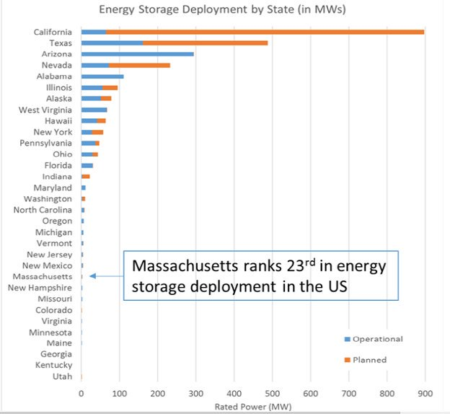
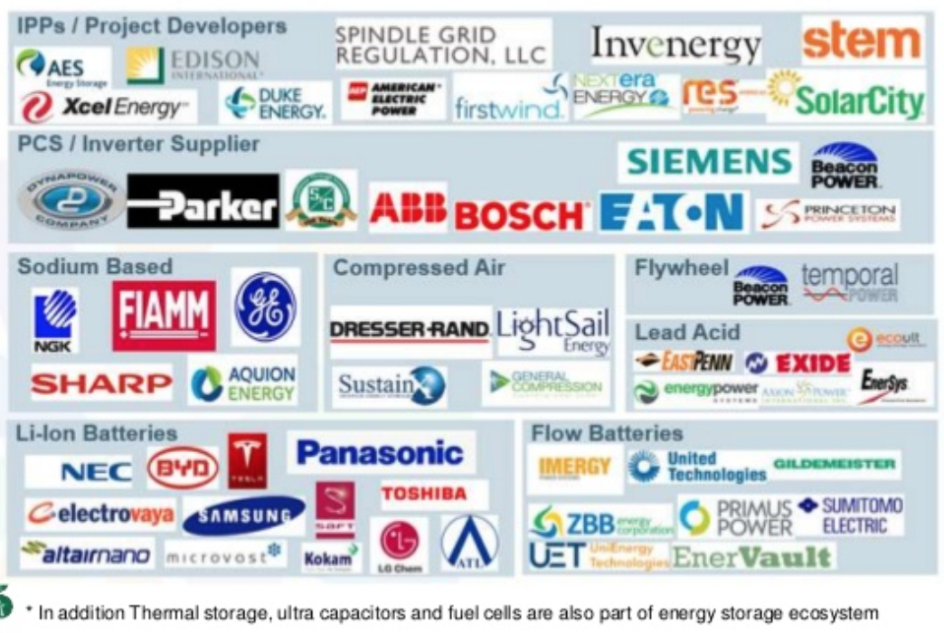
Public & Private Sectors
3
Notes:
https://twitter.com/ForesterNetwork/status/778652581031796736
https://www.slideshare.net/e4sv/banglore-jul16-ces-is-at-the-forefront-of-competitive-electricity-markets-and-emerging-technology-trends (Page 19)

Slide 34
Federal Government
3
Federal Energy Regulatory Commission (FERC)
FERC has issued several orders and policy statements creating opportunities for energy storage resources in ancillary services and other organized wholesale markets
  Opportunities for Non-Generation Resources - FERC Order 890
  Frequency Regulation - FERC Order 755
  Opportunity for Ancillary Services Revenues - FERC Order 784
  Interconnection of Storage Resources through Small Generator Interconnection Procedures (SGIP) - FERC Order 792
  Additional Opportunities for Ancillary Services Revenues -FERC Order 819
Federal Tax Incentives
Some energy storage may qualify for an investment tax credit (ITC) or a production tax credit (PTC) when developed alongside qualifying resources
Section 48 of the Internal Revenue Code(the Code) provides a 10% or 30% ITC
Code Section 45 provides for PTCs when electricity produced by certain renewable energy facilities (usually wind) is sold to a third party during the ten years after the facility was “placed in service.”
Source: JD Supra Energy Storage Handbook
Notes:
https://www.jdsupra.com/legalnews/energy-storage-handbook-38441/
Page 10-17
Policy at the federal level still has not developed

Slide 35
Massachusetts
3
Energy Storage Initiative - (ESI)
  Administration announced that it has set an “aspirational” 200 MWh energy storage target for electric distribution companies to procure viable and cost-effective energy storage systems
  by January 1, 2020.
Advancing Commonwealth Energy Storage - ACES
  Program to Support
  Innovative Storage Use Cases
  and Business Models
  RFP completed. Grants issued in September 2017.
  December 2017 - Announced the award of $20 million dollars to support 26 projects
SMART Program
  Creates Storage
  “Adder” for Solar Projects Paired
  with Storage
  Energy Storage Adder Guideline

Slide 36
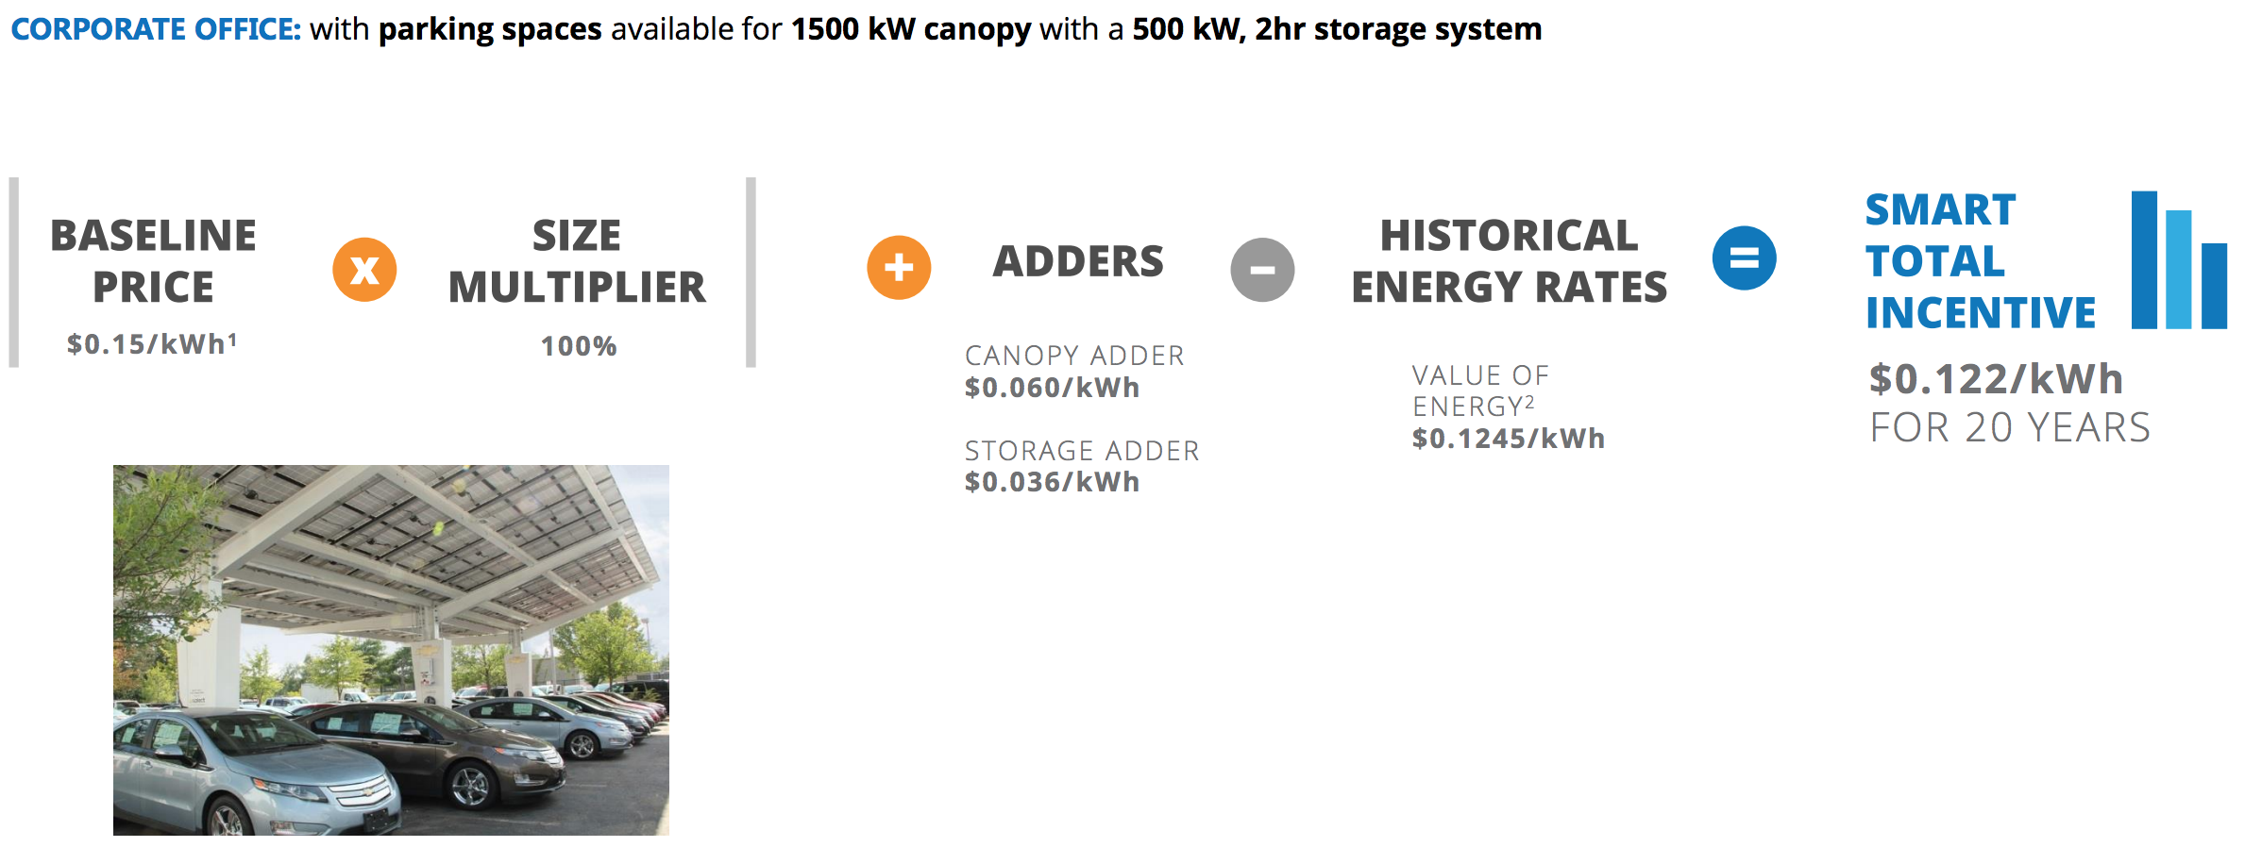
SunPower - SMART:
Solar + Storage
3
The SMART incentive will replace the current SREC program.
SMART is a unique solar incentive: it provides a guaranteed set incentive for 20 years.
“Adders” can help increase the value of your solar investment.
The “declining” block incentive allows first movers to benefit the most.
Source: SunPower

Slide 37
Eversource 1/2
2
1) Current projects underway:
Martha's Vineyard: 5 MW (2019)
  Uses:
    Avoid the need to upgrade or add undersea cables
    Replace diesel generators
    Integrate additional distributed energy
Wellfleet, MA: 12 MW (2020)
  Uses:
    Test as replacement for transmission cable
Other current projects:
  Demand demonstration projects related energy efficiency.
    Partnerships with companies with latest technologies.
Source: Eversource, DPU

Slide 38
Eversource 2/2
2
2) Upcoming Behind the meter projects :
Currently working on a draft of the 3 year planning cycle (start 2019) with DPU.
  First Draft is due at end of April.
Currently looking for partners to test technologies:
  Behind the meter battery, thermal, demand response, and software and controls.
    Partners: Looking for customers to enroll in pilot projects.
    Total funds available: US $21 (18 after admin. cost) million dollars.
    Behind the meter energy storage will be mostly lithium batteries.
      Lithium: It has the right energy density.
Additional Projects:
  EV make ready infrastructure.
    Launching in the near term.
Source: Eversource, DPU
Notes:
DPU = http://170.63.40.34/DPU/FileRoomAPI/api/Attachments/Get/?path=17-05%2f1705_Final_Order_Revenue_Requi.pdf
https://www.eversource.com/content/docs/default-source/ema---pdfs/public-hearings/16-178.pdf

Slide 39
Enernoc
3
Simple Enrollment: EnerNOC will help Customers evaluate DR programs and create a curtailment strategy before the Demand Response season begins.
Maximize Revenue: Customers receive payments for participating. The more KW a customer can deliver, the higher the payments.
No Penalties: Customer remains in full control of energy usage at all times and EnerNOC will shield customer from penalties if the site cannot curtail during an event (payments will simply reflect performance)
Free Real time Energy Monitoring Platform: We install energy monitoring equipment at each location at no cost. Customers can access the data for Demand response events and for day to day energy management 24/7/365
Source: ENERNOC

Slide 40
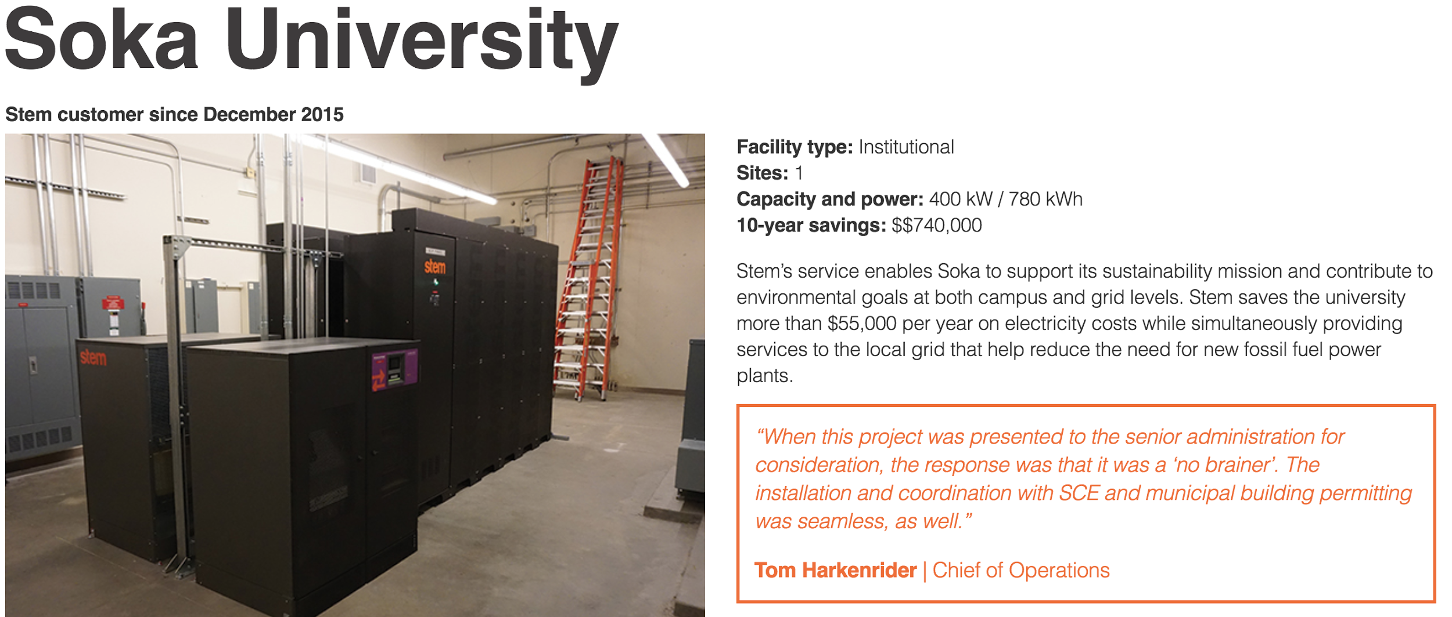
STEM - Lease + AI
3
Source: STEM

Slide 41
Carbon Tax & Environmental Impact - Data Analysis
3
Rate Design Updates
Encourage load consumption at times when renewable oversupply conditions occur on the grid.
  This should encourage energy storage charging and discharging patterns that better align with GHG reductions and renewable integration objectives.
GHG Signal
A “GHG signal” provided to participants in advance could help SGIP energy storage systems to operate.
  Using linked data and software.
Does Energy Storage Reduce emissions?
According to study completed by Itron - in conjunction with EThree and WattTime - on behalf of the California Public Utilities Commision, energy storage by itself increases pollution.
Further research is needed on this topic.
Blockchain like technologies could enable better quality data points.
Notes:
https://www.technologyreview.com/s/609560/surge-of-carbon-pricing-proposals-coming-in-the-new-year/
2016 SGIP ADVANCED ENERGY STORAGE IMPACT EVALUATION
http://www.cpuc.ca.gov/WorkArea/DownloadAsset.aspx?id=6442454964.
http://docs.cpuc.ca.gov/PublishedDocs/Efile/G000/M202/K276/202276301.PDF
“Simply identify high GHG hours and require
projects to avoid charging during those times. What about a 12-9pm “no charge” period? This would
mean that SGIP systems avoid charging during all high emission hours. There may be an absence of a
price signal, but one does have the right information on where the high GHG hours are. If that seems
like too long a time, how about 4-9pm? This method doesn’t require 100 different DR programs or
arguing about rates.”

Slide 42
Remaining Issues in MA
3
While Massachusetts has looked to improve, and grow its energy storage initiatives, various concern remain:
  Uncertainty Regarding regulations
    Capacity vs ancillary services
    Net metering
      DPU researching the matter: Docket (17-146)
  Overall, the various regulatory entities remain open to the integration of energy storage into the grid.
“A variety of policies are being tried out, and progress is being made in many areas, he said, but “it might take a while to get the pieces to work together.” Utility Dive
Source: Utility Dive
Notes:
https://www.utilitydive.com/news/6-months-after-target-adoption-massachusetts-sees-energy-storage-growth-c/515353/
https://www.utilitydive.com/news/is-solarstorage-eligible-for-net-metering-in-massachusetts-tesla-and-othe/508386/
Capacity versus ancillary:
New England has an open-ended capacity performance market, and the penalties for non-performance could pose too much liability for developers, Burwen said.
As a result, most energy storage providers are likely to design their projects to participate in the ISO’s ancillary services market because they are not prepared to assume the financial burden of qualifying for the forward capacity market.

Slide 43
Conclusion and discussion
3
Energy Storage Market for commercial use is new, and fragmented.
Business models vary, are evolving and adapting, and may not follow the “traditional” Tesla Model. (i.e. STEM)
Follow closely ACES development and results
____ + Storage is currently the most economically feasible.
There are various current opportunities for Compact members:
  SMART Program (Solar + Storage), Eversource
  Partnerships: University Pilots,....
Storage + Real Time Data + Software management = more effective for GHG reductions

Slide 44
Resources
3
News:
Greentech Media
BNEF
Utility Dive
Public Resources:
MASS DOER
  Energy Storage (ESI)
MASSCEC
  ACES
DOE
  Storage database
FERC
NEISO
Compact Members:
Compact: Veena Dharmaraj
  vdharmaraj@cambridgema.gov
City of Cambridge: Nikhil Nadkarni
  nnadkarni@cambridgema.gov
MIT:
  Research - Power Distribution & Energy Storage
Harvard:
  Jaclyn Olsen - OFS
    jaclyn_olsen@harvard.edu
  SEAS
  The Office of Technology Development

Slide 45
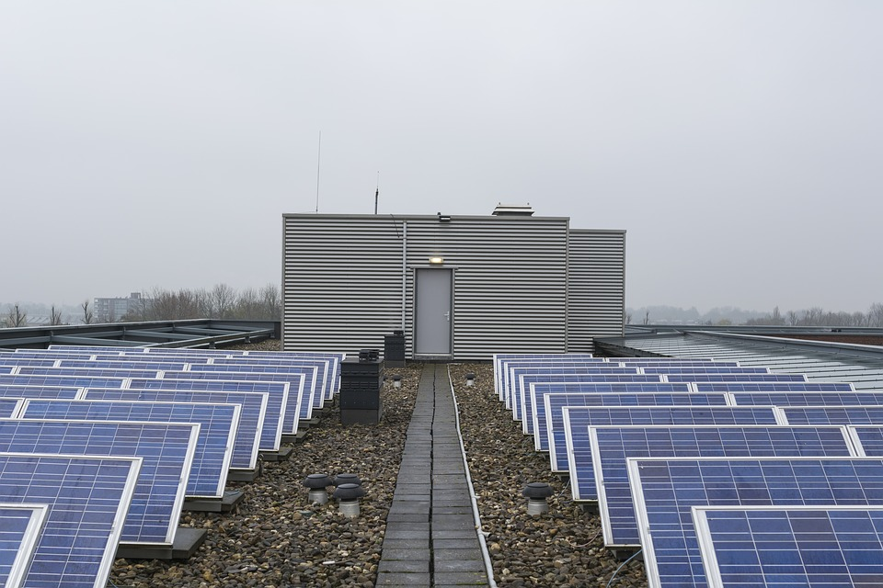
End.

Slide 46
Thanks!
Any questions ?
You can find me at
Ronald Quintero
  ronald@alumni.harvard.edu

Slide 47
Credits
Special thanks to all the people who made this research possible:
Jaclyn Olsen - Harvard Office for Sustainability
Veena Dharmaraj - Cambridge Compact
Many more at Alexandria, Boston Properties, EverSource, SunPower, Novartis, Google, UCSD,and the City of Cambridge.

